Slide 1

Phenotypic Variation

Slide 2

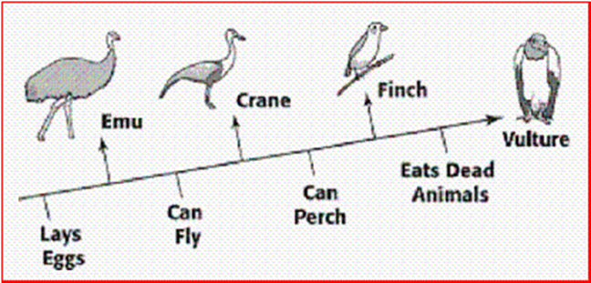
Using this diagram to identify which bird can fly but does not perch on trees or roost.
DQ
Emu
Crane
Vulture

Slide 3
Quiz in Masteryconnect

Slide 4
Notebook check in teams

Slide 5
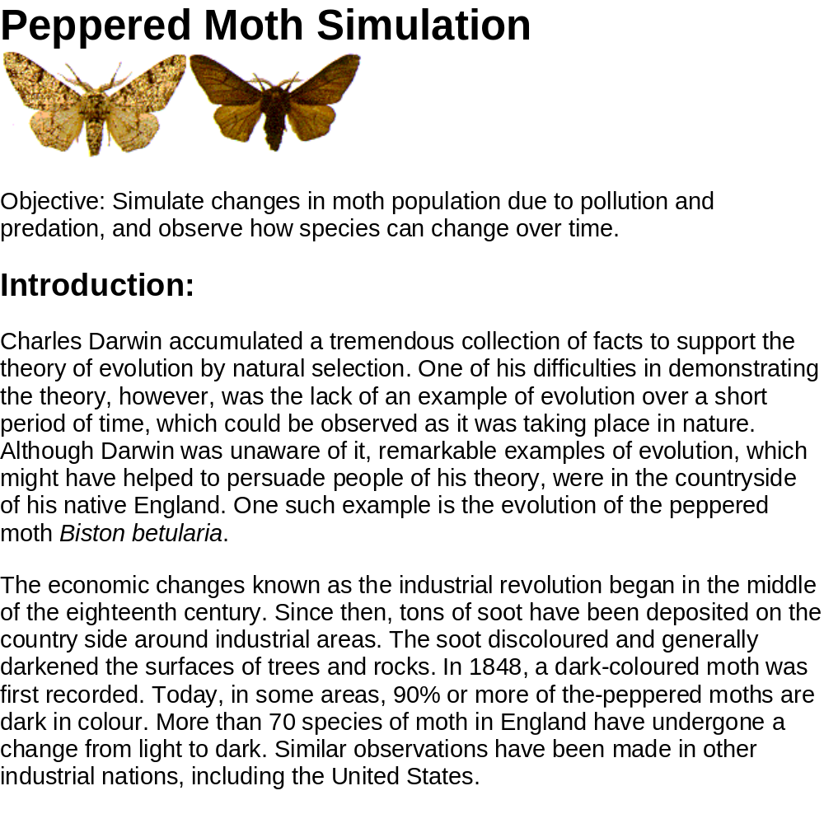
Peppered Moth Video

Slide 6
Choose one of the following scenarios and complete the activity as listed. These are at your lab table to choose from. Complete this on a piece of notebook paper and turn in when you are finished.
Scenario #1
In a population of spiders, there is a protein that is coded in the DNA to make venom. In a particular spider, there was a protein variation due to a change in genetic code. This protein variation caused the spider’s venom to be stronger. The spiders could use their venom to help capture food or defend themselves against predators. This genetic variation was passed down to some offspring. Once a new predator insect was introduced into the environment many spiders became threatened.
On your paper, write the following from this scenario:
The number for your scenario. (Scenario 1, 2, or 3)
  population variation
  struggle for the organism
Then illustrate the scenario on the paper (showing the environment, struggle to survive, and variation within the population)
Next predict and illustrate the future population in the same scenario
Last write a caption below both pictures to explain
  the struggle to survive and what is causing the struggle
  population variation.
Scenario #2
In a population of pigeons, there are genotypes for iridescent feathers and non-iridescent feathers. The females of the population tend to choose mates with iridescent feathers over those with non-iridescent feathers. Over time, 75% of the female population continually chose mates with iridescent feathers.
On your paper, write the following from this scenario:
The number for your scenario. (Scenario 1, 2, or 3)
  population variation
  struggle for the organism
Then illustrate the scenario on the paper (showing the environment, struggle to survive, and variation within the population)
Next predict and illustrate the future population in the same scenario
Last write a caption below both pictures to explain
  the struggle to survive and what is causing the struggle
  population variation.
Scenario #3
In 2000 Baker farms planted 20 acres of soybean plants. At end of the season the farmer noticed many of his plants had be eaten by insects. The following year he planted the same amount of soybean plants, but he treated his crops with an insecticide. The insecticide was only 93% effective on the insects sprayed. The farmer continued this process for the next 4 years. In 2005 the farmer noticed once again that his soybean plants were being destroyed by insects.
On your paper, write the following from this scenario:
The number for your scenario. (Scenario 1, 2, or 3)
  population variation
  struggle for the organism
Then illustrate the scenario on the paper (showing the environment, struggle to survive, and variation within the population)
Next predict and illustrate the future population in the same scenario
Last write a caption below both pictures to explain
  the struggle to survive and what is causing the struggle
  population variation.

